Slide 1
HM Speech Why Work Anywhere Else
Carly TIlley
Owner
CPSP & MSPA
Notes:
Hello…
Firstly I would like to thank Kerryn and the team at UON for putting on this expo and allowing me to chat to you guys today.

Slide 2
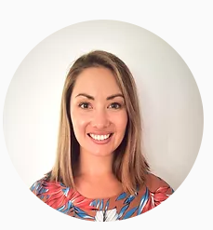
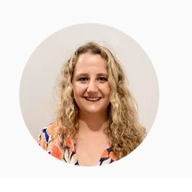
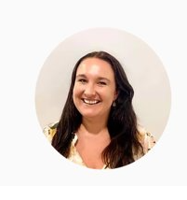
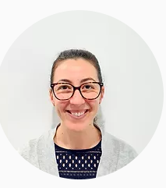
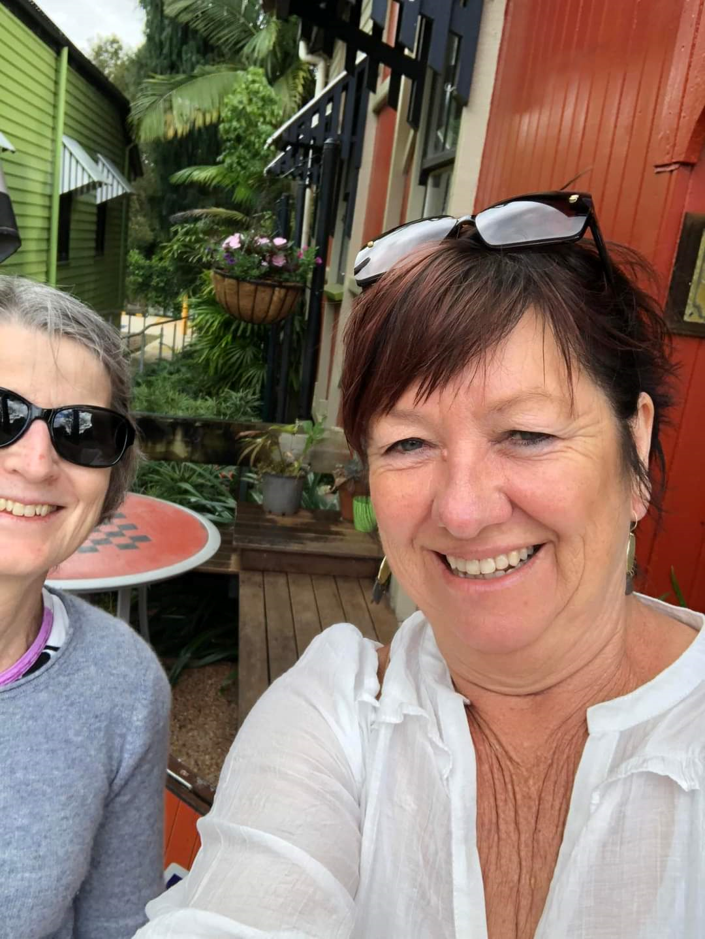
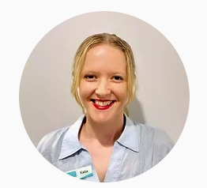
Oh Hey…
AHA (soon to be SP)
Speech Pathologist
Speech Pathologist
Speech Pathologist
Practice Manager
Speech Pathologist
Notes:
This is our wonderful team of adult and paeds clinicians, and our practice manager

Slide 3
Why Private Practice
My name is Carly & I am a dog owner, chook owner, mother, employer and social butterfly.
I have worked all over Australia in nearly all of the settings that exist – Schools, Private Practice, Community Health, Rehab & acute adults.
This gave be a really broad skillset and allowed me to upskill in those more niche areas such as nasendoscopy & voice Ax, as well as VFSS.
What I realised after some time was that I wanted to ACTUALLY be able to provide rehab to my patients, and follow-up care.
I wanted to provide a service that was actually going to make a DIFFERENCE to my patients QOL. I wanted to be able to offer groups & various clinics like a voice clinic. I wanted to be able to adapt service delivery as it suited my patients.
And WE CAN do that.
AND SO… Hastings Macleay Speech Pathology was established.

Slide 4
Services
ACF’s
Private Hospital
VFSS
ENT Clinic
Home Visits
Pre-school visits
Groups

Slide 5
Services
Some of the services we offer were on the previous slide
Some of the groups we run are aphasia groups, singing groups for Parkinson’s, LOUD Crowd (the group maintenance aspect of SPEAK OUT!), teen milkshake clubs, Hanen, adult social groups.
We can proudly say that we work closely with the local GP’s, Geriatricians, ENT’s & Respiratory Physicians BECAUSE of the service we provide
We are trained in LSVT LOUD & Speak Out! which we offer to PD clients from all around the district

Slide 6
Your Caseload is Yours
Everyone has their own ideas & here we will support your initiative
If you have an idea for a group, then let’s hear it & facilitate it
I know what I DIDN’T receive as a new graduate & new employee and so we offer those things:
Quarantined supervision weekly
Slow start to caseload – build up as they are feeling comfortable
Resources supplied
Access to PD - PAID
Support for growth – if you find your area, we will support you to develop skills there

Slide 7
Apply Today

Slide 8
